Slide 1
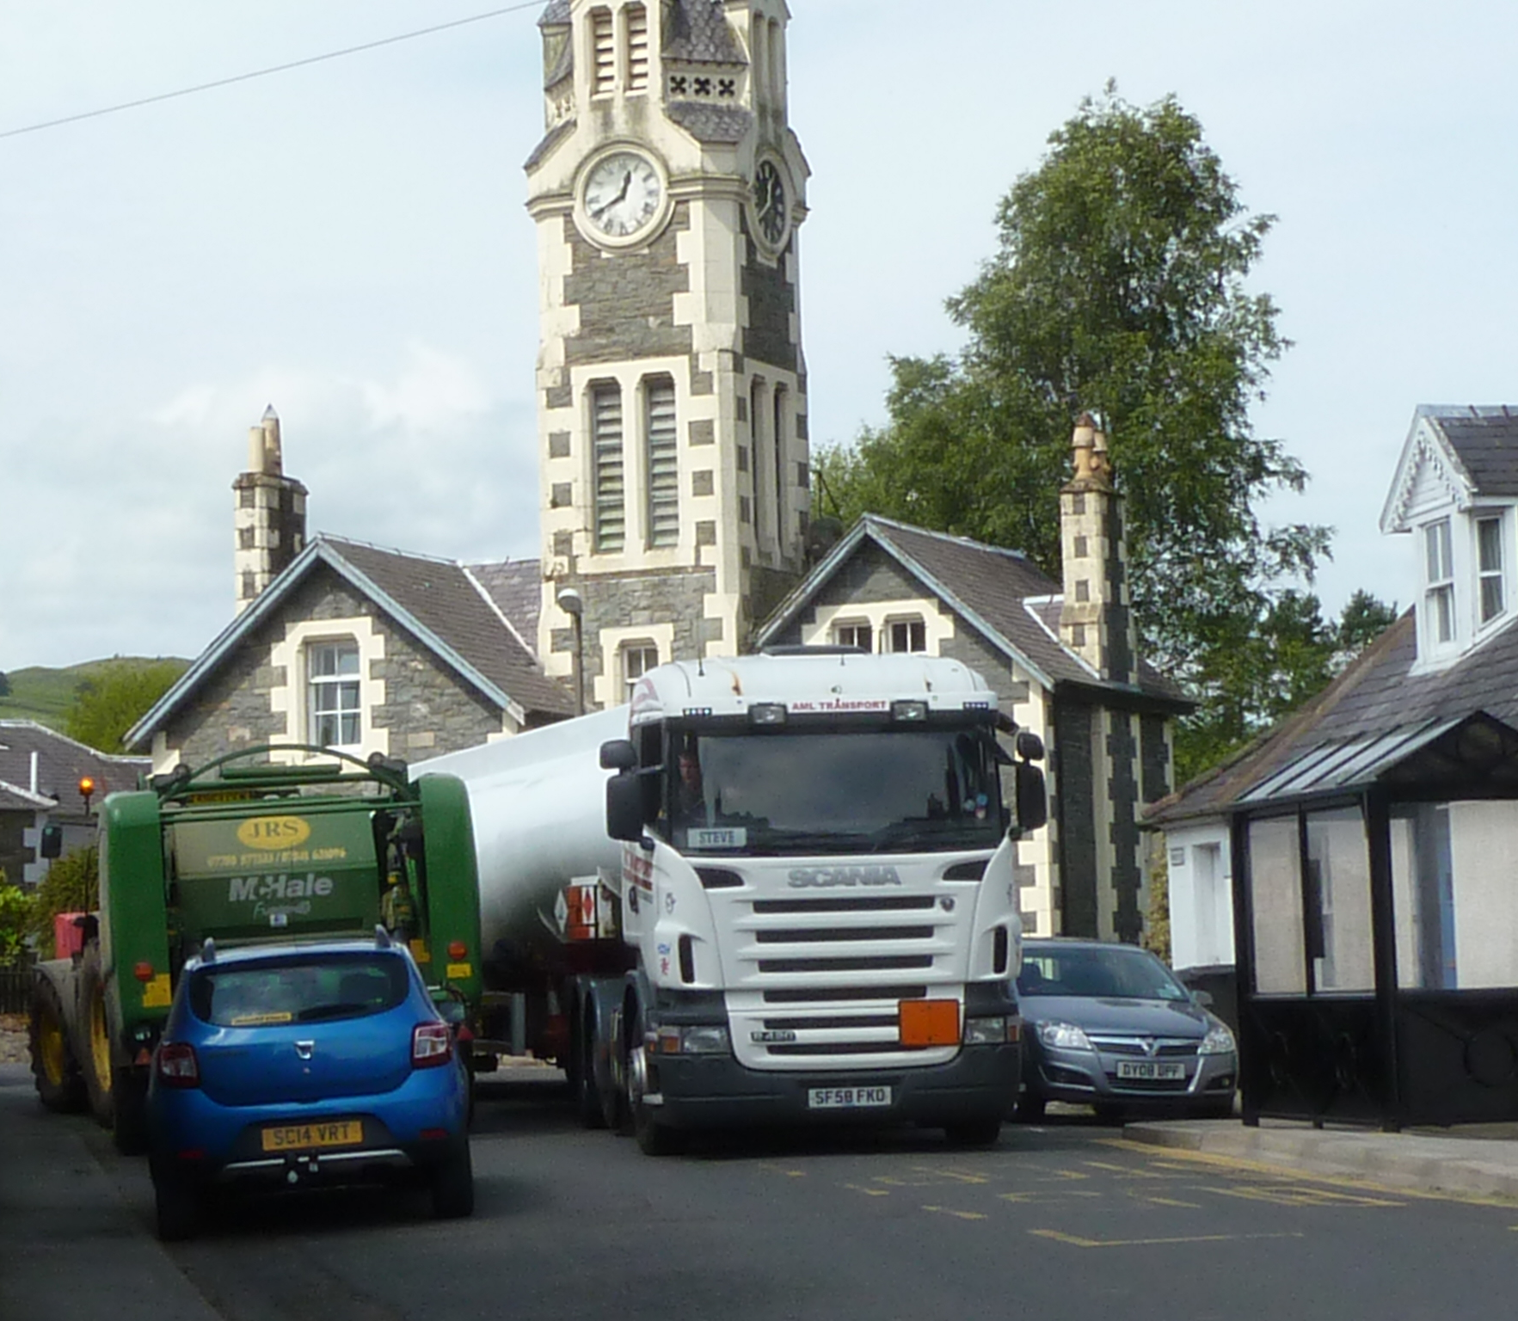
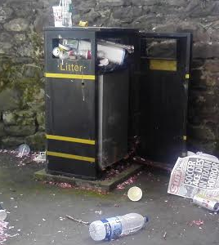
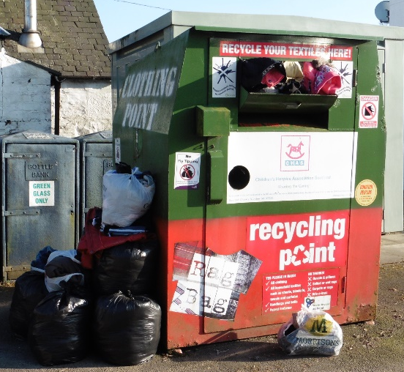


More ATTRACTIVE
More ACTIVE
More ACCESSIBLE
These are our ASPIRATIONS for
Moniaive High Street
What are yours?

Slide 2
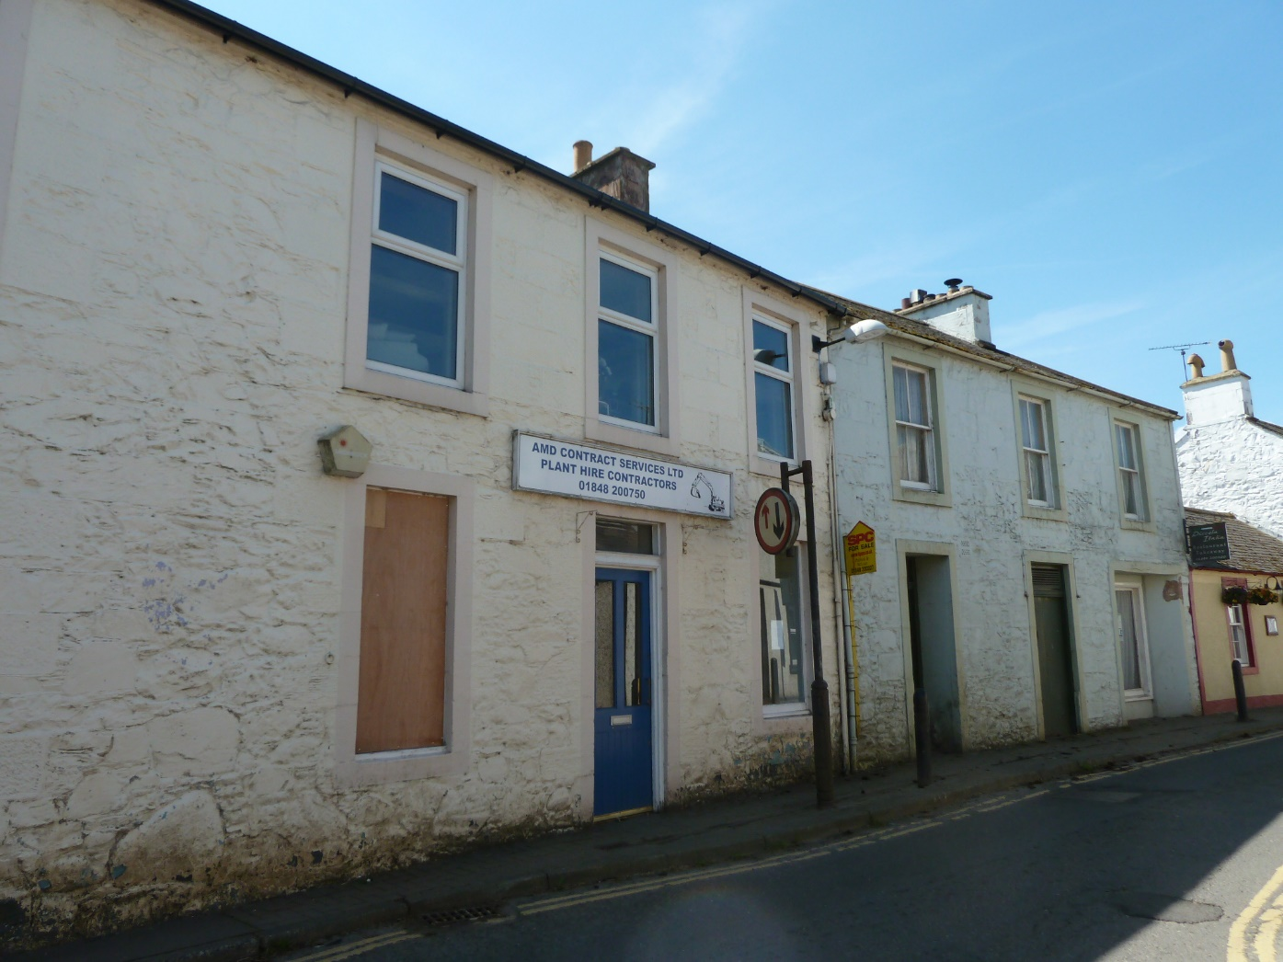
“Encouraging the use of empty buildings” is the priority that scores most highly in our Community Wide
Survey.
Closely followed by
“Improving the look of building frontages”

Slide 3
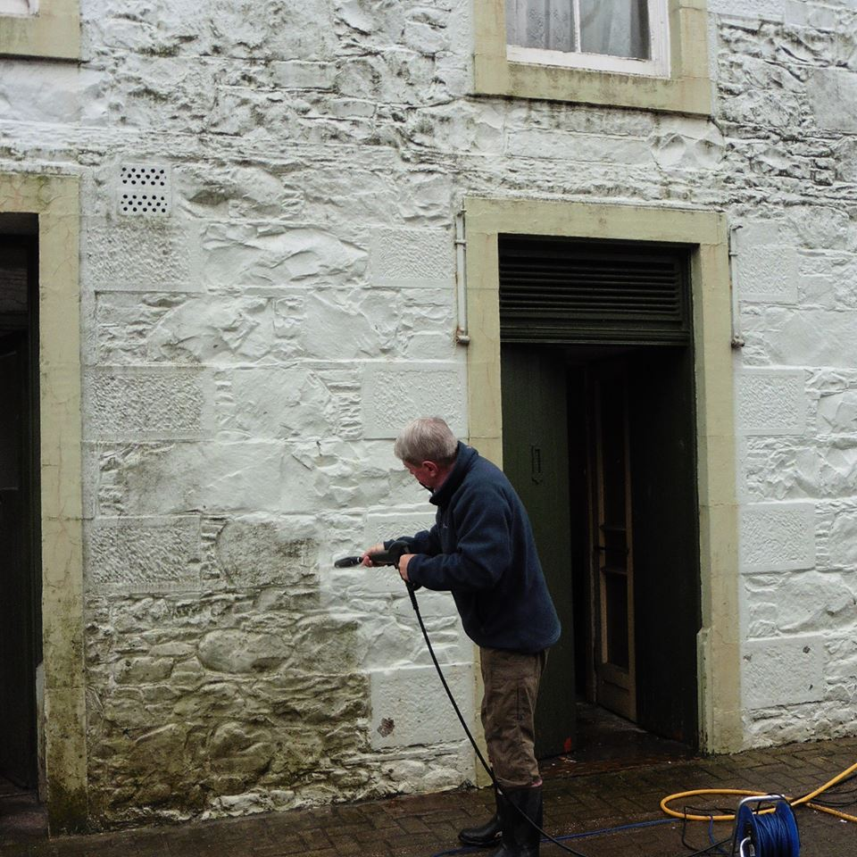
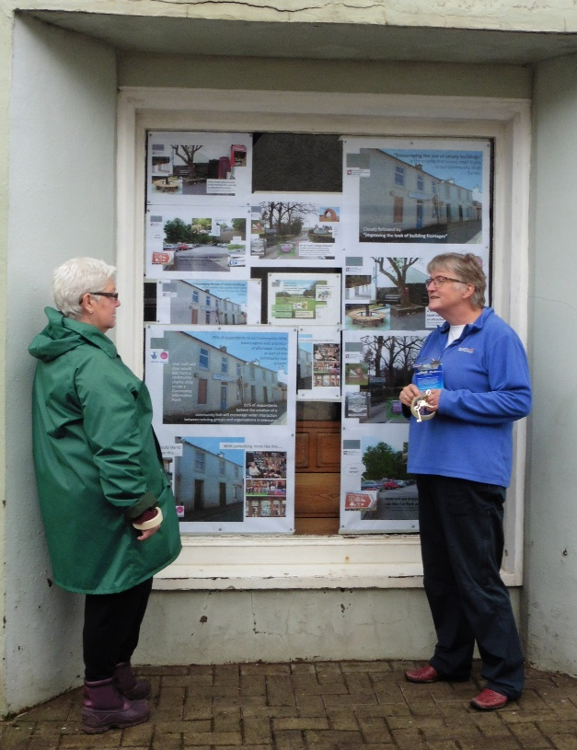
You said that ‘Improving the look of Building Frontages’ is a HIGH priority
We’ve made a start……
but how do we continue?
We cleaned the front of this building and in return we were allowed to utilise the empty
window space.
We can’t force owners to
clean up their act, but we
can use incentives and gentle encouragement.
Should we offer a volunteer work-party to improve other building frontages in return for a donation to one of our projects?

Slide 4
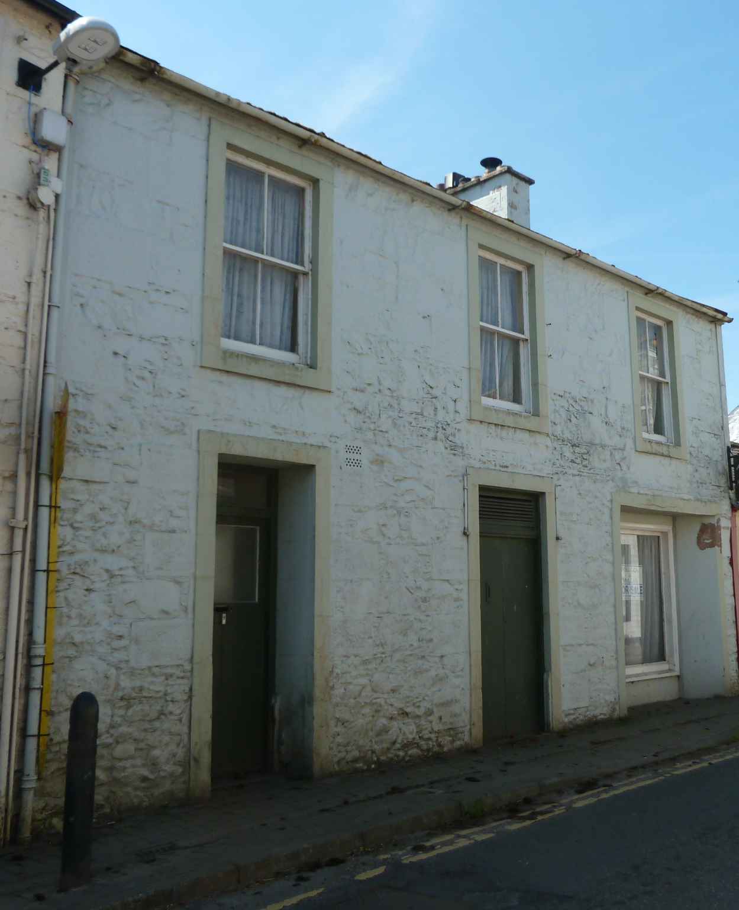
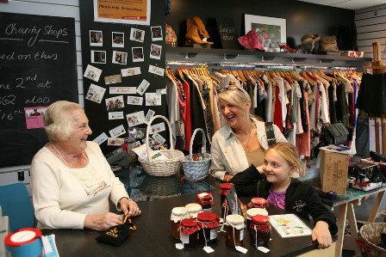
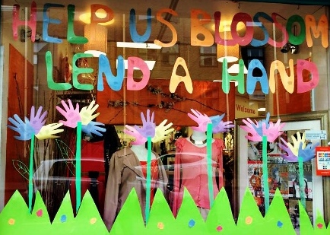

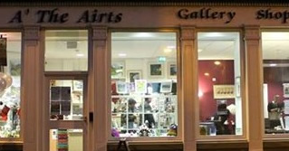

We would like to replace this…..
With something more like this…..
In our April Workshop the attendees said they would
like to be able to buy:
Furniture
Vintage Clothes
Vintage Jewellery
Vintage China & Kitchenware
Books

Slide 5

Over half said they would buy from a community charity shop or use a
Community
Information
Point
75% of respondents to our Community Wide Survey agree with provision
of affordable housing
as part of any
community hub
scheme
81% of respondents
believe the creation of a
community hub will encourage wider interaction
between existing groups and organisations in Glencairn

Slide 6
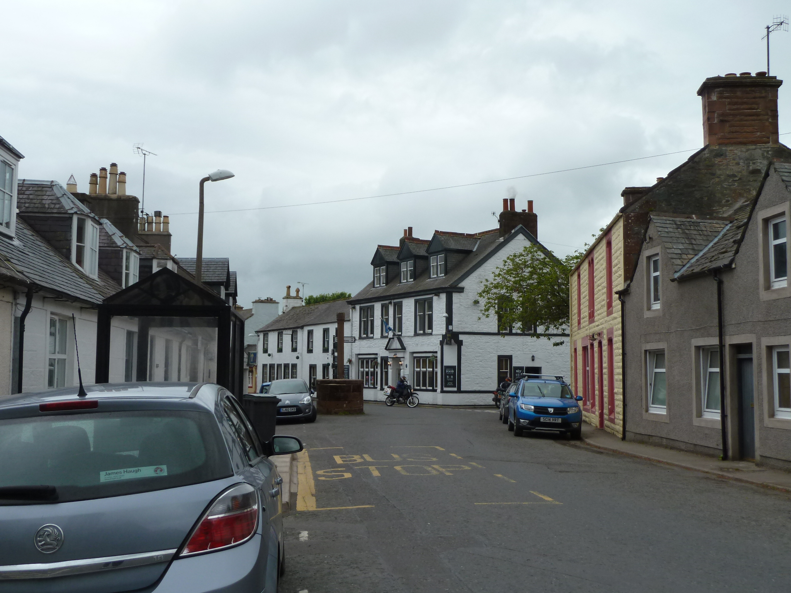
Here’s what they said they would use:
Traditional Information Point
(Leaflets, timetables, maps)
Leisure Learning
(Classes & workshops)
Digital Information Point
(Internet Access via Tablets)
Local Heritage
(Information & Displays)
Ticket Booking
(for local events)
We asked attendees of our April Workshop what services or facilities we could provide
in a new Community Hub
in the High Street

Slide 7
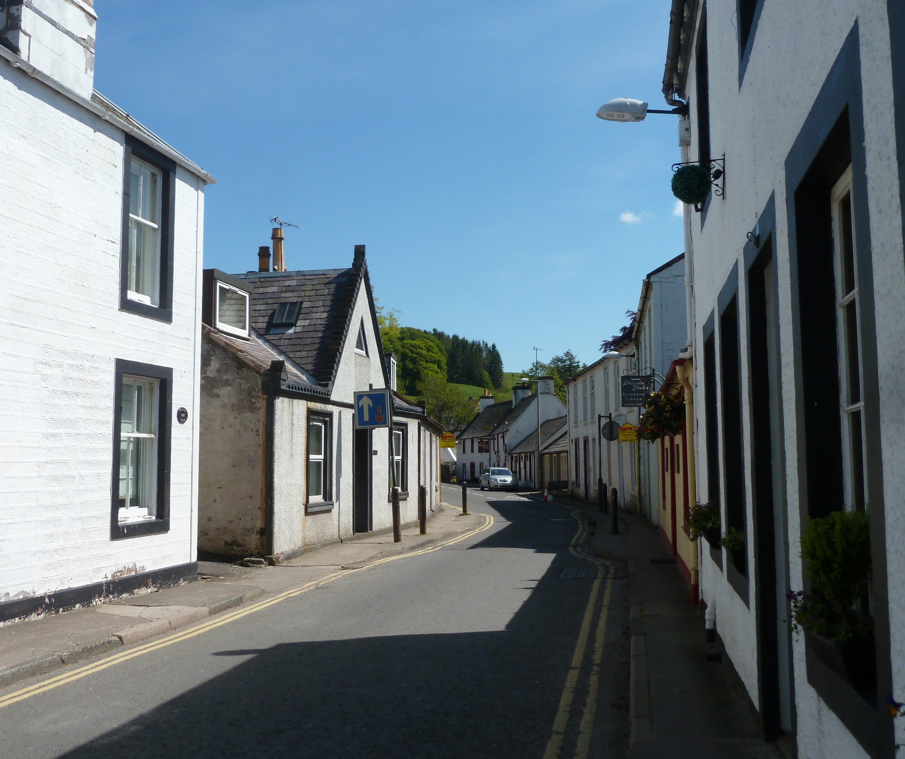
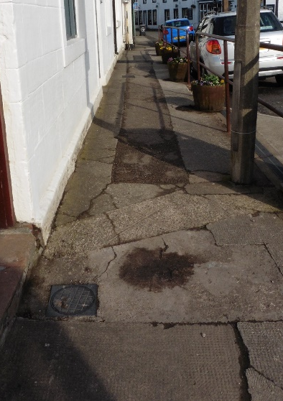
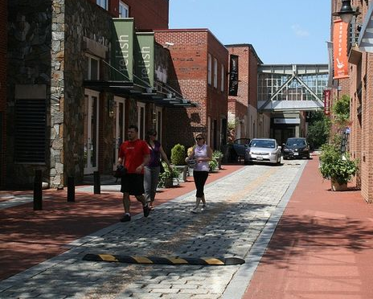
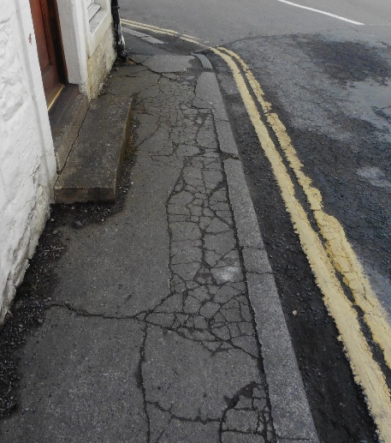
‘Improving paving and
pedestrian access’
scores highly in all
our surveys
The pavements are in poor condition, and in many places are too narrow for pushchairs or wheelchairs. How can we make the High Street work better for everyone?

Slide 8
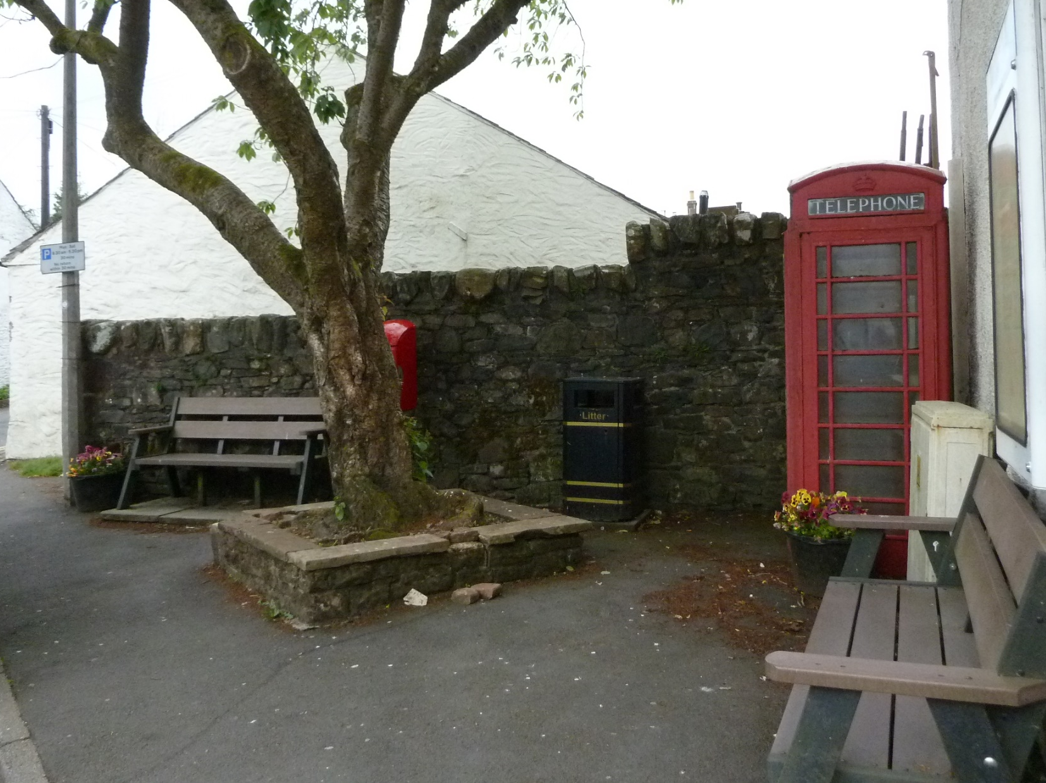
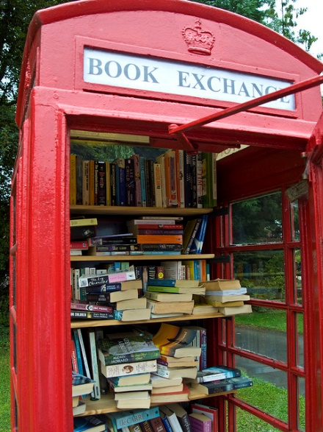
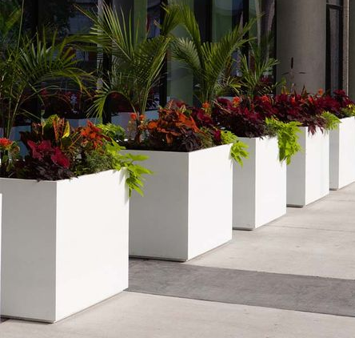
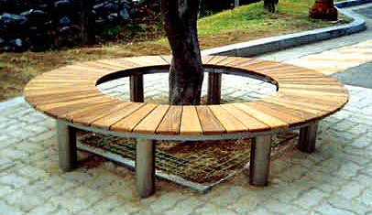
A few simple improvements
could transform this area
into an attractive focal point

Slide 9
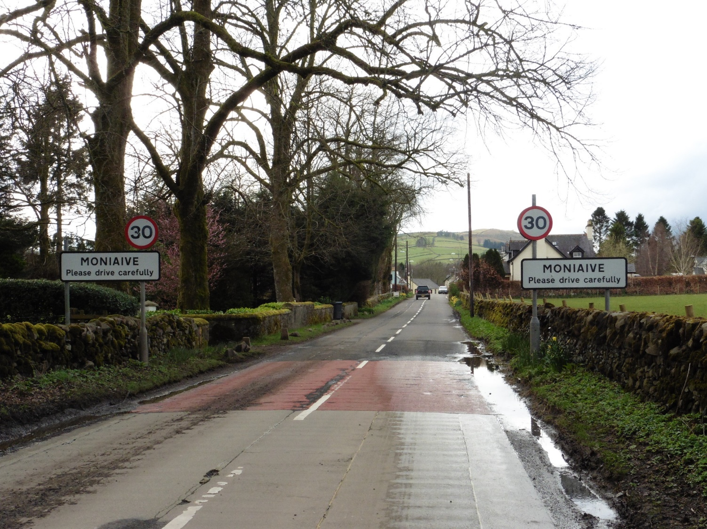
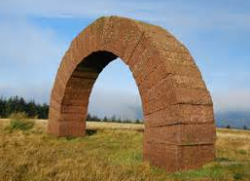
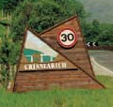
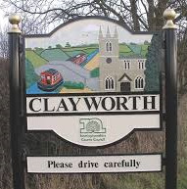
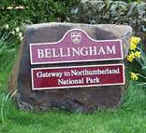
How
about a design based
on the Striding Arches?
Do we need a Village Gateway?
A gentle reminder for drivers to slow
down and respect our beautiful home

Slide 10
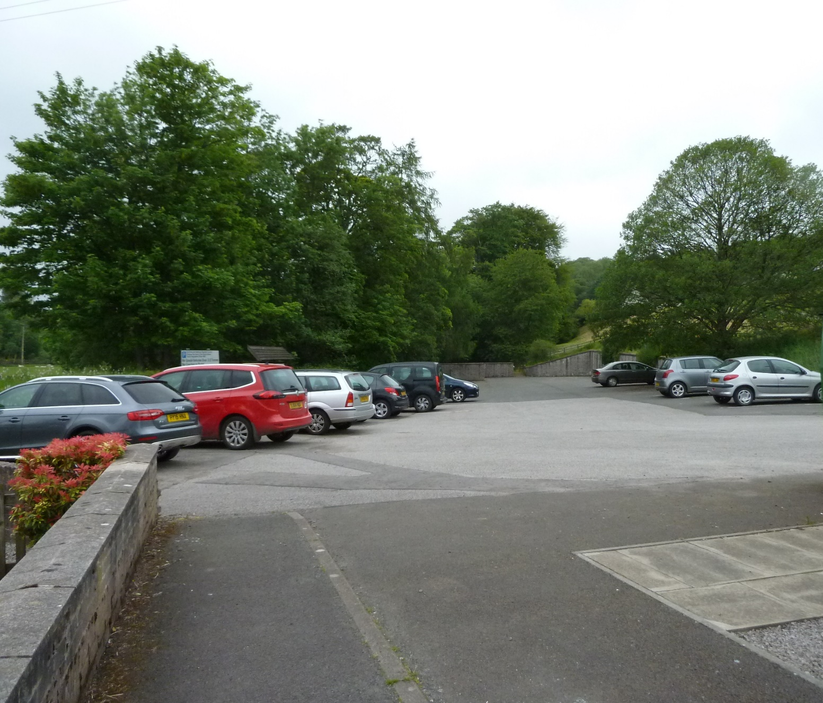
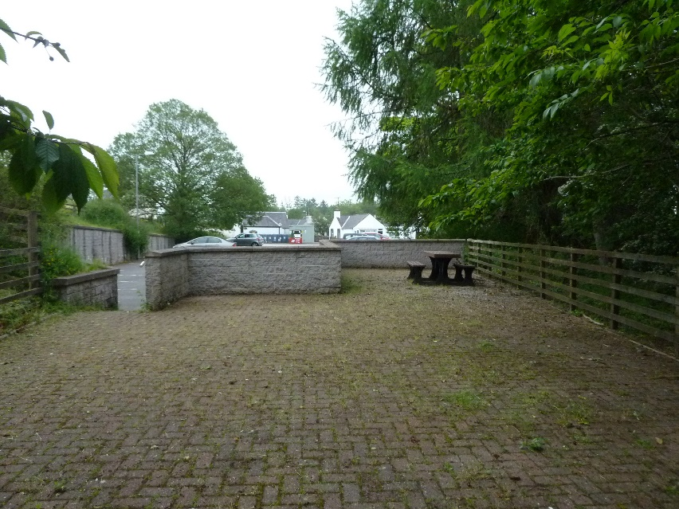
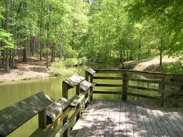
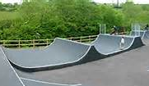
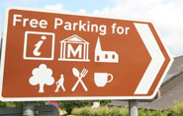
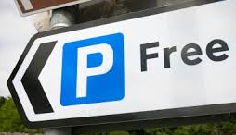
Should this…..
look
more
like
this?
Better Signage?
Or this?
How can we encourage
Visitor’s to use the
Car Park & Picnic Area?

Slide 11
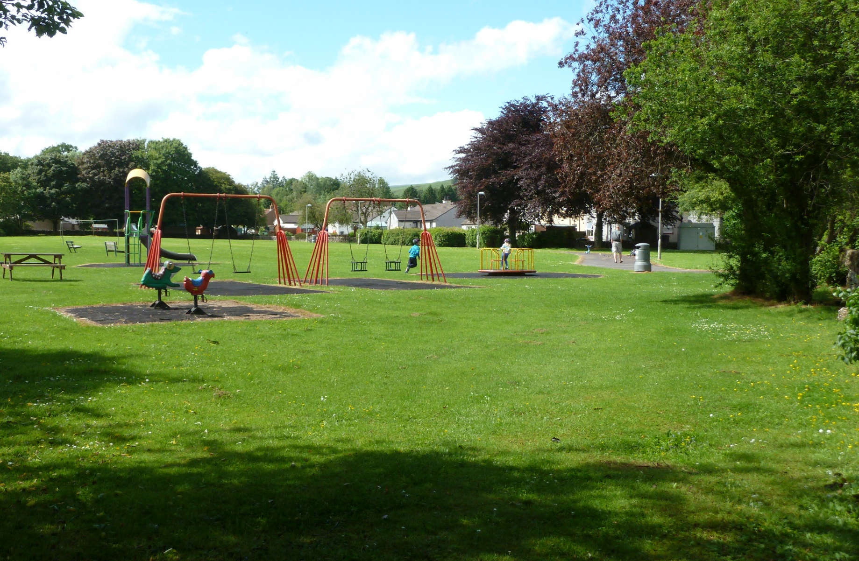
Macara Park is a
lovely space, but....
The existing play equipment
is not suitable
for toddlers
And not very appealing to older children or teenagers
You can make a donation
in the collection tins in
Watson’s Shop & Glenwhisk
Or online at:
www.TotalGiving.co.uk/MacaraPark

Slide 12
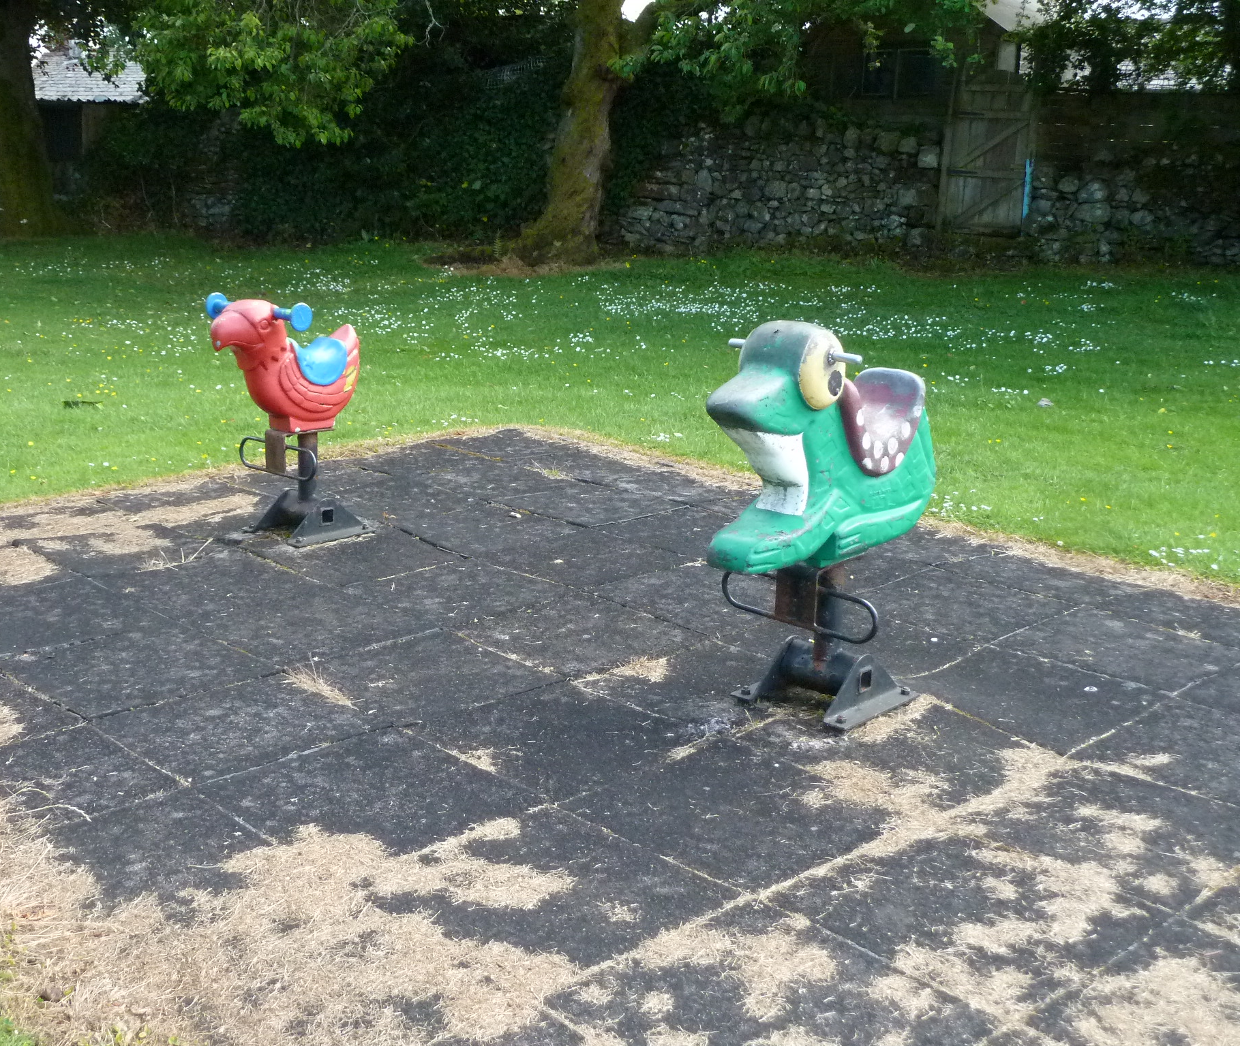
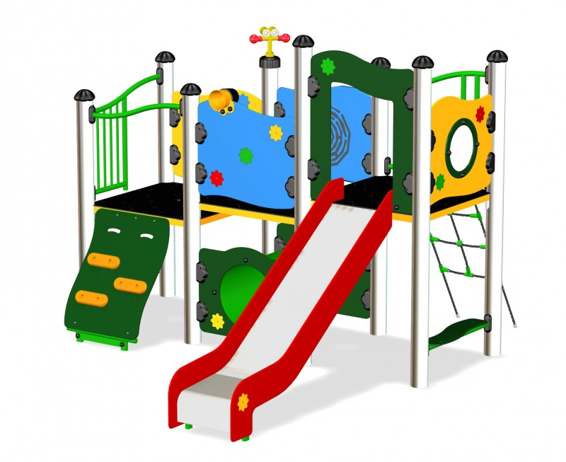
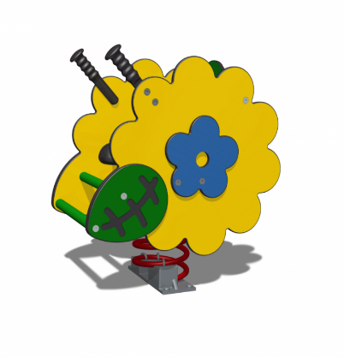
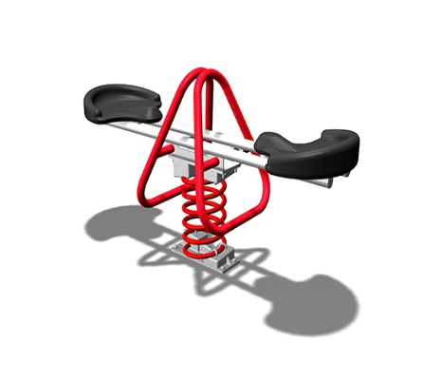
We are raising funds to add a new area for Toddlers
You can make a donation
in the collection tins in
Watson’s Shop & Glenwhisk
Or online at:
www.TotalGiving.co.uk/MacaraPark

Slide 13
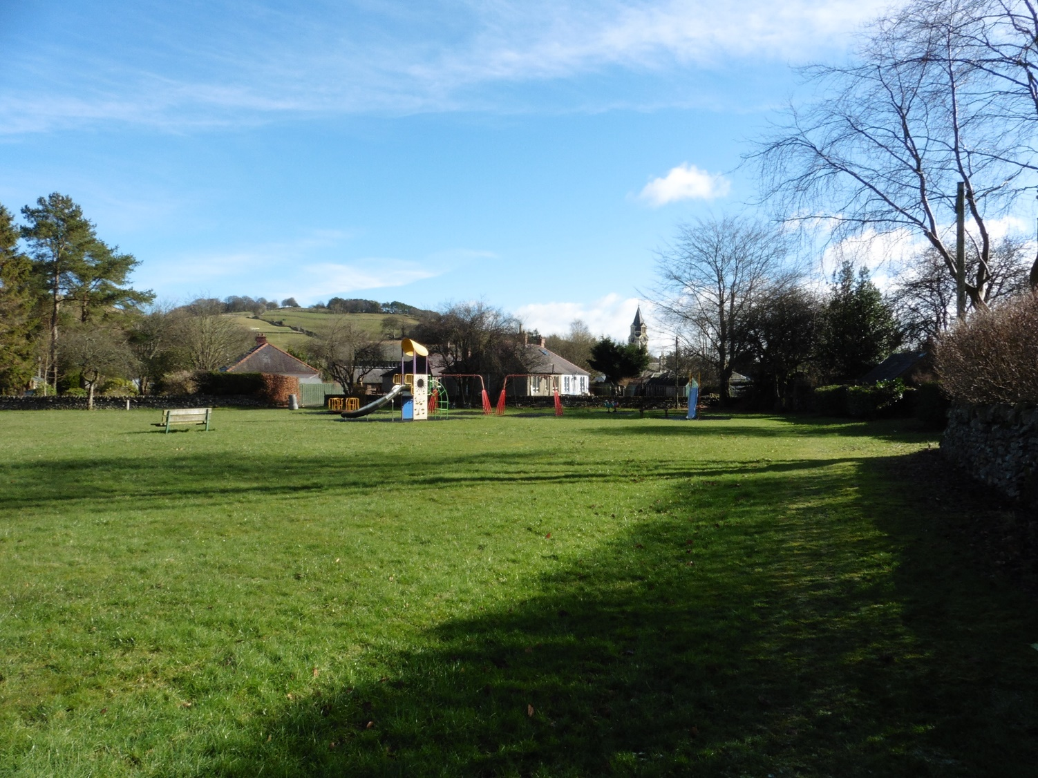
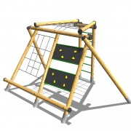
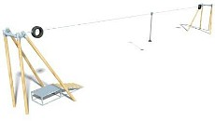
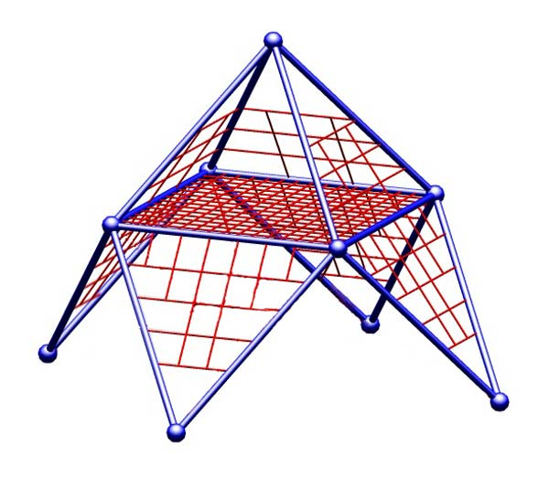
And something extra for the older children too….
Possibly one of the following:
You can make a donation
in the collection tins in
Watson’s Shop & Glenwhisk
Or online at:
www.TotalGiving.co.uk/MacaraPark

